Slide 1
S&P500 stock market
Project Presentation

Slide 2
Meet our team
-Moaz Abdulfattah
-Ahmed Gouda
-Bassant Hany
-May Rizk
-Donia Salheen

Slide 3
Table of contents
01
Introduction
02
Business Requirements
03
Data Sources
04
Data Model

Slide 4
Table of contents
05
Queries
06
Visualization
Companies visualization
07

Slide 5
01
Introduction

Slide 6
Introduction about the Project
This project discusses the S&P500 stock market (The Standard and Poor's 500) is a stock market index tracking the stock performance of 500 large companies listed on exchanges in the United States. It is one of the most commonly followed equity indices. As of December 31, 2020, more than $5.4 trillion were invested in assets tied to the performance of the index

Slide 7
02
Business Requirements

Slide 8
Business Requirement
This project aims to analyse the data of the S&P 500 stock market and its companies following many KPIS to be able to draw insights that could help investors to understand the market better and where they can invest their money and gain more profit. This stock market contains 500 of the biggest companies in the world from many different industries

Slide 9
Data Sources
03

Slide 10
1-Wikipedia List of S&P 500 companies
Descriptions :
ETL:
Contains data about the companies that are part of the S&P 500 stock market like its foundation date, where its HQs, its symbol in the market … etc
the data was extracted using excel’s feature extract table from web and saved as a CSV file, we dropped the unnecessary columns like (SEC fillings, data founded, headquarters, CIK, data first added)

Slide 11
2-Kaggle’s S&P 500 daily monitoring
Date of creation: 4 years ago
Descriptions:Contains data about the companies that are part of the S&P 500 stock market regarding their performance in the market from 2017-2021
ETL: : he data was downloaded as a CSV file. dropping the data from before 2017.

Slide 12
3-. Kaggle’s S&P 500 stock data
Date of creation: 2018
Descriptions: Contains data about the S&P 500 stock market as a whole from 2017 til 2021
ETL: the data was downloaded as a CSV file.

Slide 13
4-TradingView’s S&P 500 current data
Descriptions :
ETL:
Contains current data about the companies that are part of the S&P 500 stock market regarding their performance in the market and many KPIS that were found useful to our analysis
the data was extracted using excel. many tables were extracted from this web page and transformed. all the tables were joined with the symbol column from the wiki data

Slide 14
5-Yahoo finance’s PFE stock data
Date of creation: 2010 to 2022
Descriptions: Contains data about the PFE stock as a whole from 2010 until 2022
ETL: the data was downloaded as a CSV file.

Slide 15
6-Yahoo finance’s DAL stock data
Date of creation: 2010 to 2022
Descriptions: Contains data about the DAL stock as a whole from 2010 until 2022
ETL: the data was downloaded as a CSV file.

Slide 16

Data Model
04

Slide 17
Data Warehouse Data Model
Galaxy schema were used to implement the DWH model as we have two separate fact tables and one confirmed dimension between them
Advantages:
● Tables are subdivided into fact and dimensional to understand the relationship between them.
● It is a flexible schema that makes users use it.
● Here dimensional tables are shared by the number of fact tables.
● It is a normalized form of snowflake and star schema.
● We can access the data in the database using complex queries. its

Slide 18
Data Warehouse Data Model
disadvantages:
● It is difficult to understand as it is a very complex schema to implement.
● It uses more space in the database comparative to the star schema.
● It has many joins between dimensional and fact tables and thus it is
difficult to understand.
● This is difficult to maintain and operat

Slide 19
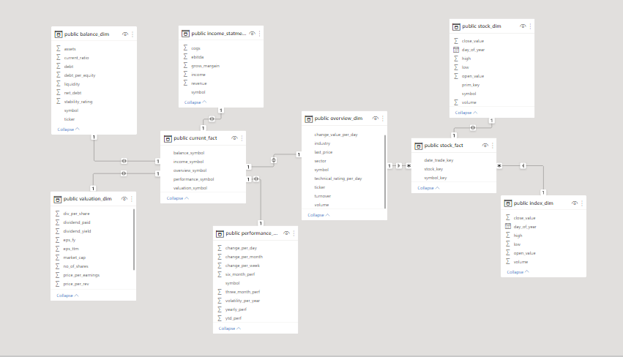
Data Model

Slide 20
05
Queries

Slide 21
Querying the data
most of the queries used were simple select statements or select with joins with the use of group by, order by and limit to achieve precise results
In the second dashboard we used the window function rank() to create a rank column based on stability rating

Slide 22
06
Visualization

Slide 23

Thanks!
Do you have any questions?

